Slide 1



campusConnect
Making Students’ Lives Easier
By: Brigidi Ackah Blay, Senam Dzomeku, Jemima Antwi, Papa Yaw Badu

Slide 2
Table of Contents
01
04
02
05
03
06
The Problem
Solution Demo
What the solution does
What Did We Learn?
Solution Design
Questions and Answers

Slide 3
The Problem We are Solving
General Student Dissatisfaction with the Hostel Accommodations They Choose.
Student’s Lack of Information on Teachers

Slide 4
How We Are Solving The Problem
To address the combined issue of student’s poor choices leading to dissatisfaction with the hostel accommodations and their lack of information on teachers before enrolling in their class we created a program that:
takes user input and provides them with three compatible hostels that match their tastes
allows students to view comments from other students about courses they will take

Slide 5
Solution design
Class Descriptions
• Person Class:
Serves as the superclass for both the Teacher and Student classes, encapsulating common attributes such as name and age, along with corresponding accessor and mutator methods
• Student Class
• Teacher Class
• Hostel Class

Slide 6
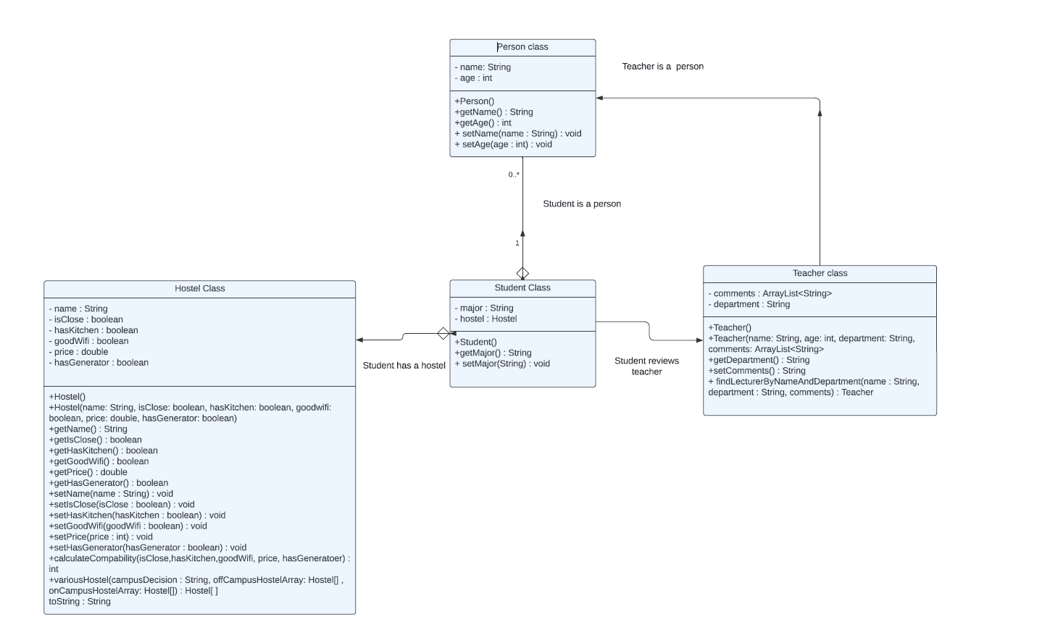
Unified Modeling Language (UML)

Slide 7
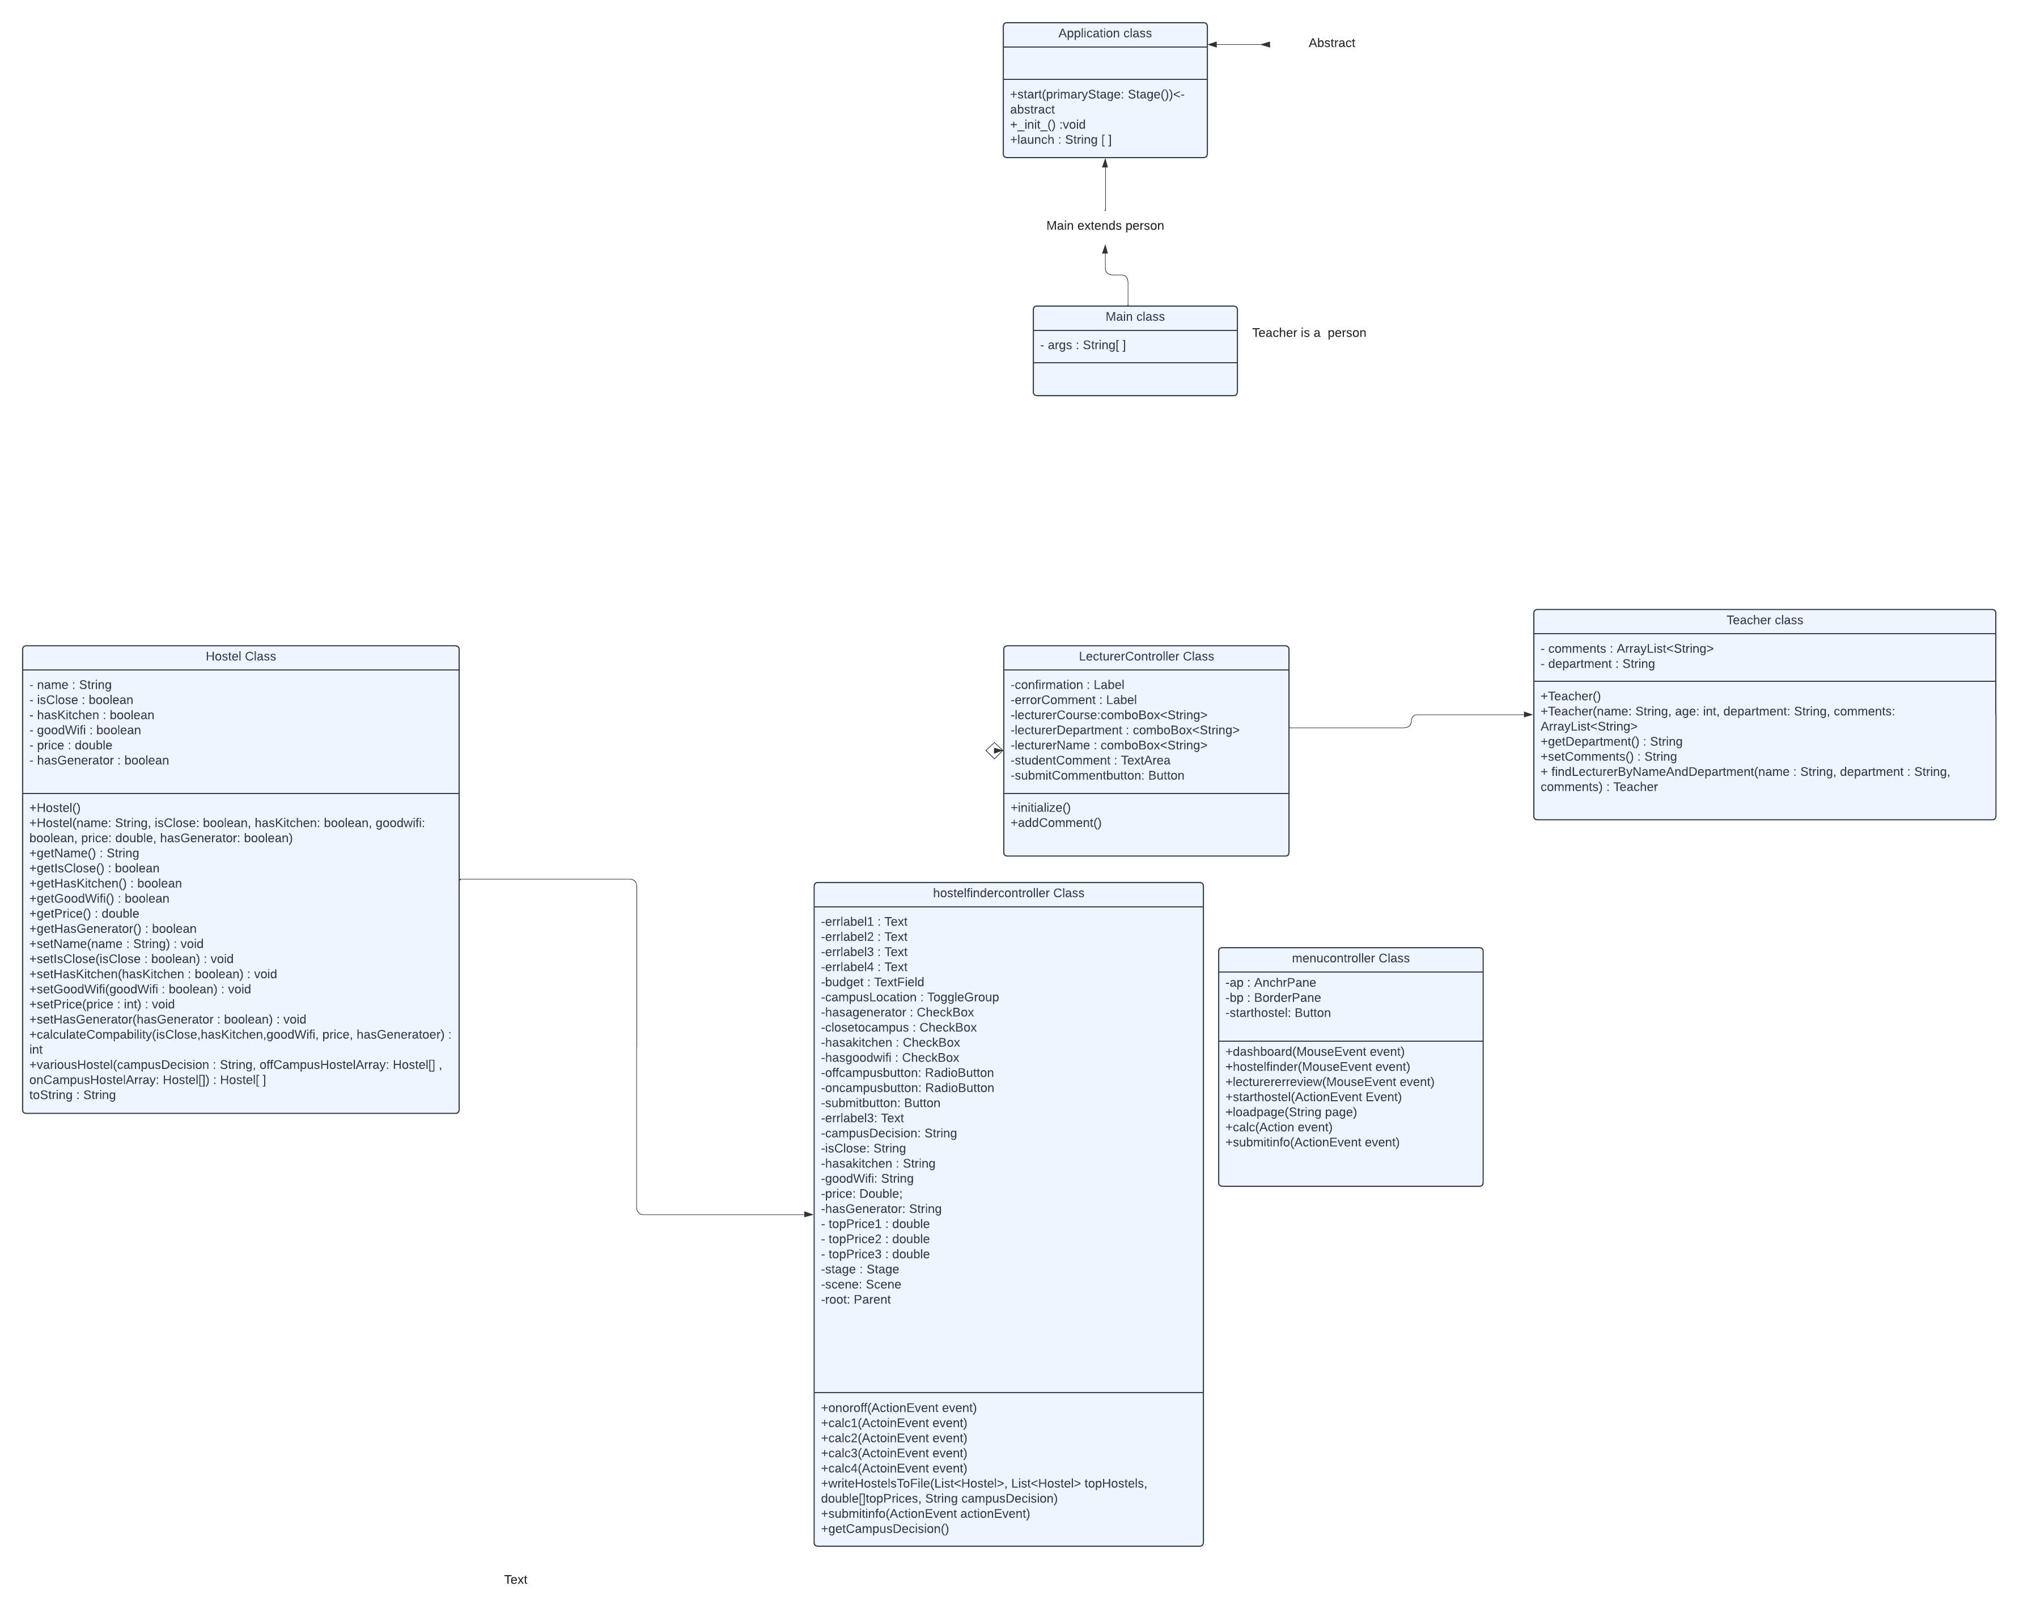
Graphic User Interface UML

Slide 8
Main
Application
Menu Controller
Hostel Finder(Button)
Lecturer Review
View Comments
Dashboard
Hostel Finder
Hostel
Teacher
Student
File
Hostel Finder Results

Slide 9
Solution Demo

Slide 10
What Did We Learn?
We learnt how to use hashmaps.
We learnt how to use javafx.
We about error handling
We learnt how to work in a team.

